Slide 1
Access Control
Md. Iftekharul Alam Efat

Slide 2
Learning Objectives
Explain how access control fits into the broader context that includes authentication, authorization, and audit
Define the three major categories of access control policies
Distinguish among subjects, objects, and access rights
Describe the UNIX file access control model
Discuss the principal concepts of role-based access control
Summarize the RBAC model
Discuss the principal concepts of attribute-based access control
Explain the identity, credential, and access management model
Understand the concept of identity federation and its relationship to a trust framework

Slide 3
Access Control
“The prevention of unauthorized use of a resource, including the prevention of use of a resource in an unauthorized manner”
Central element of computer security
Assume have users and groups
Authenticate to system
Assigned access rights to certain resources on system
Notes:
This lesson focuses on access control enforcement within a computer system. We can view access control as the central element of computer security. ITU-T Recommendation X.800 defines access control as shown on the slide. The principal objectives of computer security are to prevent unauthorized users from gaining access to resources, to prevent legitimate users from accessing resources in an unauthorized manner, and to enable legitimate users to access resources in an authorized manner. We consider the situation of a population of users and user groups that are able to authenticated to a system and are then assigned access rights to certain resources on the system.

Slide 4
Definitions
NIST IR 7298, glossary of key information security terms, defines access control as the process of granting or denying specific requests to:
Obtain and use information and related information processing services
Enter specific physical facilities
RFC 4949, internet security glossary, defines access control as a process by which use of system resources is regulated according to a security policy and is permitted only by authorized entities (users, programs, processes, or other systems) according to that policy

Slide 5
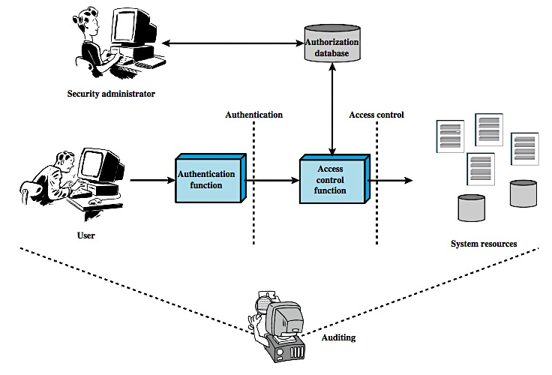
Access Control Context
The granting of a right or permission to a system entity to access a system resource. This function determines who is trusted for a given purpose
Verification that the credentials of a user or other system entity are valid
An independent review and examination of system records and activities in order to test for adequacy of system controls, to ensure compliance with established policy and operational procedures, to detect breaches in security, and to recommend any indicated changes in control, policy and procedures
Notes:
This chapter deals with a narrower, more specific concept of access control which implements a security policy that specifies who or what may have access to each specific system resource and the type of access that is permitted in each instance. Figure 4.1 from the text shows the broader context of access control. In addition to access control, this broader context involves the following entities and functions:
• Authentication: The verification an identity claimed by or for a system entity.
• Authorization: The granting of a right or permission to a system entity to access a system resource. This function determines who is trusted for a given purpose.
• Audit: An independent review and examination of system records and activities in order to test for adequacy of system controls, to ensure compliance with established policy and operational procedures, to detect breaches in security, and to recommend any indicated changes in control, policy and procedures.
An access control mechanism mediates between a user (or a process executing on behalf of a user) and system resources, such as files and database. The system must first authenticate a user seeking access. Then, the access control function determines if the specific requested access by this user is permitted. A security administrator maintains an authorization database that specifies what type of access to which resources is allowed for this user. The access control function consults this database to determine whether to grant access. An auditing function monitors and keeps a record of user accesses to system resources. All operating systems have at least a rudimentary, and in many cases a quite robust, access control component. Particular applications or utilities, such as a database management system, also incorporate access control functions.

Slide 6
Access Control Policies
Discretionary Access Control (DAC)
Mandatory Access Control (MAC)
Role-based Access Control (RBAC)
Attribute-based Access Control (ABAC)
Controls access based on the identity of the requestor and on access rules (authorizations) stating what requestors are (or are not) allowed to do. This policy is termed discretionary because an entity might have access rights that permit the entity, by its own volition, to enable another entity to access some resource.
Controls access based on comparing security labels (which indicate how sensitive or critical system resources are) with security clearances (which indicate system entities are eligible to access certain resources). This policy is termed mandatory because an entity that has clearance to access a resource may not, just by its own volition, enable another entity to access that resource.
Controls access based on the roles that users have within the system and on rules stating what accesses are allowed to users in given roles.
Controls access based on attributes of the user, the resource to be accessed, and current environmental conditions.
Notes:
An access control policy, which is embodied in an authorization database, dictates what types of access are permitted, under what circumstances, and by whom. Access control policies are generally grouped into the following access control categories:
• Discretionary access control (DAC): based on the identity of the requestor and on access rules (authorizations) stating what requestors are (or are not) allowed to do. This policy is termed discretionary because an entity might have access rights that permit the entity, by its own volition, to enable another entity to access some resource.
• Mandatory access control (MAC): based on comparing security labels (which indicate how sensitive or critical system resources are) with security clearances (which indicate system entities are eligible to access certain resources). This policy is termed mandatory because an entity that has clearance to access a resource may not, just by its own volition, enable another entity to access that resource. See chapter 10.
• Role-based access control (RBAC): based on the roles that users have within the system and on rules stating what accesses are allowed to users in given roles.
DAC is the traditional method of implementing access control. MAC is a concept that evolved out of requirements for military information security and is best covered in the context of trusted systems. RBAC has become increasingly popular. These three policies are not mutually exclusive as shown in Figure 4.2. Can employ two or even all three of these policies to cover different classes of system resources.

Slide 7
Access Control Requirements
Reliable Input
Fine and Coarse Specifications
Least Privilege
Separation of Duty
Open and Closed Policies
Policy Combinations, Conflict Resolution
Administrative Policies
Notes:
[VIME06] lists the following concepts features of an access control system:
• Reliable input: it assumes that a user is authentic; thus, an authentication mechanism is needed as a front end to an access control system. Other inputs to the access control system must also be reliable.
• Support for fine and coarse specifications: fine-grained specifications allow access regulated at the level of individual fields / records in files; and each individual access by a user rather than a sequence of accesses. System administrators should also be able to choose coarse-grain specification for some classes of resource access.
• Least privilege: it should be implemented so that each system entity is granted the minimum system resources and authorizations needed to do its work. This principle tends to limit damage that can be caused by an accident, error, or unauthorized act.
• Separation of duty: should divide steps in a system function among different individuals, so as to keep a single individual from subverting the process.
• Open and closed policies: a closed policy only allows accesses that are specifically authorized; an open policy allows all accesses except those expressly prohibited.
• Policy combinations and conflict resolution: may apply multiple policies to a given class of resources, and need a procedure to resolves conflicts between policies.
• Administrative policies: to specify who can add, delete, or modify authorization rules, and also need access control and other control mechanisms to enforce these administrative policies.

Slide 8
Access Control Elements
Subject - entity that can access objects
A process representing user/application
Often have 3 classes:
Owner
Group
World
Object - access controlled resource
E.G. Files, directories, records, programs etc.
Number/type depend on environment
Access Right - way in which subject accesses an object
E.G. Read, write, execute, delete, create, search
Notes:
The basic elements of access control are: subject, object, and access right.
A subject is an entity capable of accessing objects, usually a process. Any user or application actually gains access to an object by means of a process that represents it. A subject is typically held accountable for the actions they have initiated, and an audit trail may be used to associate with a subject and security-relevant actions performed on an object. Basis access control systems typically define three classes of subject:
• Owner: This may be the creator of a resource, such as a file. For system resources, ownership may belong to a system administrator. For project resources, a project administrator or leader my be assigned ownership.
• Group: In addition to the privileges assigned to an owner, a named group of users may also be granted access rights, such that membership in the group is sufficient to exercise these access rights.
• World: The least amount of access is granted to users who are able to access the system but are not included in the categories owner and group for this resource.
An object is any resource to which access is controlled. In general, and object is an entity used to contain and/or receive information. Examples include records, blocks, pages, segments, files, portions of files, directories, directory trees, mailboxes, messages, and programs. The number and types of objects to be protected by an access control system depends on the environment in which access control.
An access right describes the way in which a subject may access an object. Access rights could include the following: read, write, execute, delete, create, search.

Slide 9
Discretionary Access Control
Often provided using an Access Matrix
Lists subjects in one dimension (rows)
Lists objects in the other dimension (columns)
Each entry specifies access rights of the specified subject to that object
Access matrix is often sparse
Can decompose by either row or column
Notes:
For discretionary access control, a general approach to access control as exercised by an operating system or a database management system is that of an access matrix. One dimension of the matrix consists of identified subjects that may attempt data access. Typically, this list will consist of individual users or user groups, although access could be controlled for terminals, hosts, or applications instead of or in addition to users. The other dimension lists the objects that may be accessed. At the greatest level of detail, objects may be individual data fields. More aggregate groupings, such as records, files, or even the entire database, may also be objects in the matrix. Each entry in the matrix indicates the access rights of that subject for that object. In practice, an access matrix is usually sparse and is implemented by decomposition in one of two ways, as we show on the next slide.

Slide 10
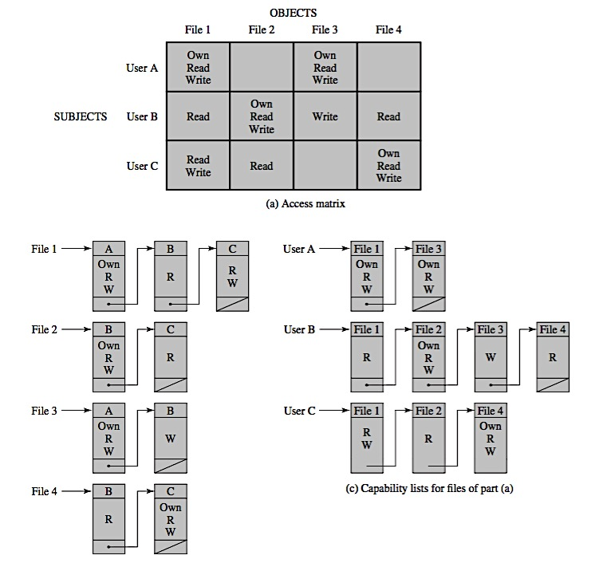
Access Control Structures
Access Matrix
Notes:
Figure 4.3a from the text illustrates a simple example of an access matrix. Thus, user A owns files 1 and 3 and has read and write access rights to those files. User B has read access rights to file 1, and so on. In practice, an access matrix is usually sparse and is implemented by decomposition in one of two ways.
The matrix may be decomposed by columns, yielding access control lists (ACLs); as shown in Figure 4.3b. For each object, an ACL lists users and their permitted access rights. The ACL may contain a default, or public, entry. This allows users that are not explicitly listed as having special rights to have a default set of rights. Elements of the list may include individual users as well as groups of users. When it is desired to determine which subjects have which access rights to a particular resource, ACLs are convenient, because each ACL provides the information for a given resource. However, this data structure is not convenient for determining the access rights available to a specific user.
Decomposition by rows yields capability tickets, shown in Figure 4.3c. A capability ticket specifies authorized objects and operations for a user. Each user has a number of tickets and may be authorized to loan or give them to others. Because tickets may be dispersed around the system, they present a greater security problem than access control lists. In particular, the ticket must be unforgeable. One way to accomplish this is to have the operating system hold all tickets on behalf of users. These tickets would have to be held in a region of memory inaccessible to users. The convenient and inconvenient aspects of capability tickets are the opposite of those for ACLs. It is easy to determine the set of access rights that a given user has, but more difficult to determine the list of users with specific access rights for a specific resource.

Slide 11
Access Control Structures
Access Control Lists for Files
Capability Lists for Files
Notes:
Figure 4.3a from the text illustrates a simple example of an access matrix. Thus, user A owns files 1 and 3 and has read and write access rights to those files. User B has read access rights to file 1, and so on. In practice, an access matrix is usually sparse and is implemented by decomposition in one of two ways.
The matrix may be decomposed by columns, yielding access control lists (ACLs); as shown in Figure 4.3b. For each object, an ACL lists users and their permitted access rights. The ACL may contain a default, or public, entry. This allows users that are not explicitly listed as having special rights to have a default set of rights. Elements of the list may include individual users as well as groups of users. When it is desired to determine which subjects have which access rights to a particular resource, ACLs are convenient, because each ACL provides the information for a given resource. However, this data structure is not convenient for determining the access rights available to a specific user.
Decomposition by rows yields capability tickets, shown in Figure 4.3c. A capability ticket specifies authorized objects and operations for a user. Each user has a number of tickets and may be authorized to loan or give them to others. Because tickets may be dispersed around the system, they present a greater security problem than access control lists. In particular, the ticket must be unforgeable. One way to accomplish this is to have the operating system hold all tickets on behalf of users. These tickets would have to be held in a region of memory inaccessible to users. The convenient and inconvenient aspects of capability tickets are the opposite of those for ACLs. It is easy to determine the set of access rights that a given user has, but more difficult to determine the list of users with specific access rights for a specific resource.

Slide 12
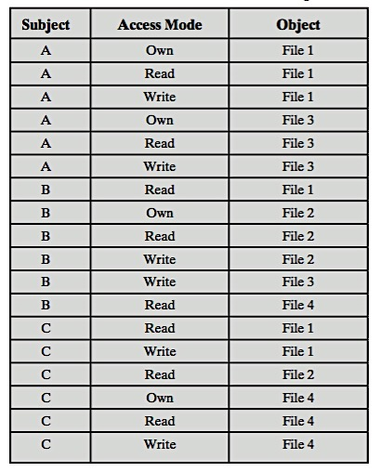
Access Control Structures
Authorization Table
Notes:
Figure 4.3a from the text illustrates a simple example of an access matrix. Thus, user A owns files 1 and 3 and has read and write access rights to those files. User B has read access rights to file 1, and so on. In practice, an access matrix is usually sparse and is implemented by decomposition in one of two ways.
The matrix may be decomposed by columns, yielding access control lists (ACLs); as shown in Figure 4.3b. For each object, an ACL lists users and their permitted access rights. The ACL may contain a default, or public, entry. This allows users that are not explicitly listed as having special rights to have a default set of rights. Elements of the list may include individual users as well as groups of users. When it is desired to determine which subjects have which access rights to a particular resource, ACLs are convenient, because each ACL provides the information for a given resource. However, this data structure is not convenient for determining the access rights available to a specific user.
Decomposition by rows yields capability tickets, shown in Figure 4.3c. A capability ticket specifies authorized objects and operations for a user. Each user has a number of tickets and may be authorized to loan or give them to others. Because tickets may be dispersed around the system, they present a greater security problem than access control lists. In particular, the ticket must be unforgeable. One way to accomplish this is to have the operating system hold all tickets on behalf of users. These tickets would have to be held in a region of memory inaccessible to users. The convenient and inconvenient aspects of capability tickets are the opposite of those for ACLs. It is easy to determine the set of access rights that a given user has, but more difficult to determine the list of users with specific access rights for a specific resource.

Slide 13
Access Control Model
Processes
Devices
Memory Locations or Regions
Access rights include the ability to delete a process, stop (block), and wake up a process
Access rights include the ability to read/write the device, to control its operation (e.g., a disk seek), and to block/unblock the device for use
Access rights include the ability to read/write certain regions of memory that are protected such that the default is to disallow access
Subjects
Access rights with respect to a subject have to do with the ability to grant or delete access rights of that subject to other objects, as explained subsequently

Slide 14
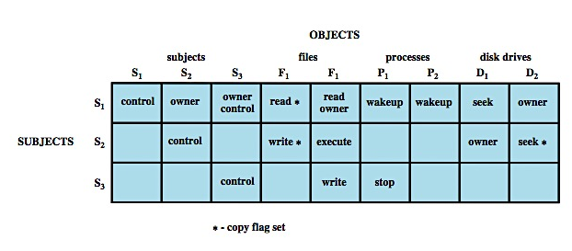
Extended Access Control Matrix
Notes:
This section introduces a general model for DAC developed by Lampson, Graham and Denning. The model assumes a set of subjects, a set of objects, and a set of rules that govern the access of subjects to objects. Let us define the protection state of a system to be the set of information, at a given point in time, that specifies the access rights for each subject with respect to each object. We can identify three requirements: representing the protection state, enforcing access rights, and allowing subjects to alter the protection state in certain ways. The model addresses all three requirements, giving a general, logical description of a DAC system. To represent the protection state, we extend the universe of objects in the access control matrix to include the following, as shown in Figure 4.4 :
• processes: Access rights include the ability to delete a process, stop (block), and wakeup a process.
• devices: Access rights include the ability to read/write the device, to control its operation (e.g., a disk seek), and to block/unblock the device for use.
• memory locations or regions: Access rights include the ability to read/write certain locations of regions of memory that are protected so that the default is that access is not allowed.
• subjects: Access rights with respect to a subject have to do with the ability to grant or delete access rights of that subject to other objects, as explained subsequently.

Slide 15
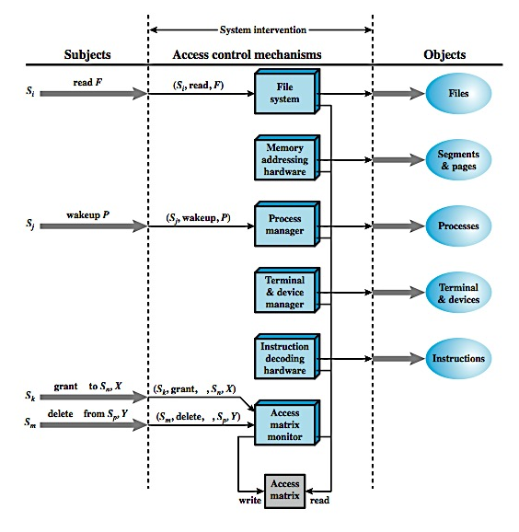
Access Control Function
An Organization of the Access Control Function
Notes:
From a logical or functional point of view, a separate access control module is associated with each type of object, as shown in Figure 4.5. The module evaluates each request by a subject to an object to determine if the access right exists. An access attempt triggers the following steps:
A subject S₀ issues a request of type α for object X.
The request causes the system (operating system or an access control interface module) to generate a message of the form (S₀, α, X) to the controller for X
The controller interrogates the access matrix A to determine if α is in A[S₀, X]. If so, the access is allowed, if not the access is denied and a protection violation occurs.
Figure 4.5 suggests that every access by a subject to an object is mediated by the controller for that object, and that the controller's decision is based on the current contents of the matrix. In addition, certain subjects have the authority to make specific changes to the access matrix. A request to modify the access matrix is treated as an access to the matrix, with the individual entries in the matrix treated as objects. Such accesses are mediated by an access matrix controller, which controls updates to the matrix. The model also includes a set of rules that govern modifications to the access matrix, such as those shown in Table 4.2 in the text. These include means of accessing, transferring, granting, and deleting access rights; and with who can create and delete subjects and objects. The ability of one subject to create another subject and to have 'owner' access right to that subject can be used to define a hierarchy of subjects. For example, in Figure 4.4 on the previous slide, S₁ owns S₂ and S₃, so that S₂ and S₃ are subordinate to S₁.

Slide 16
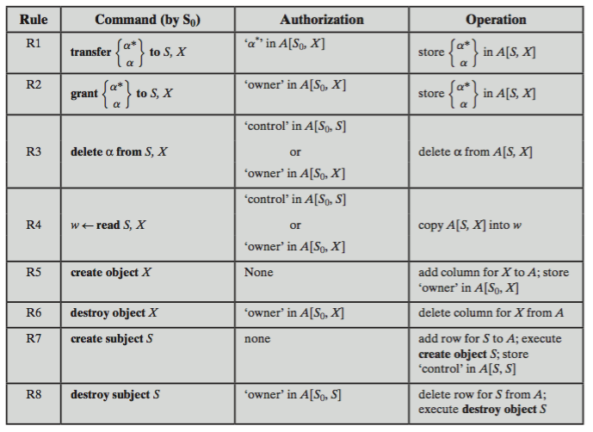
Access Control System Commands

Slide 17
Protection Domains
Set of objects with associated access rights
In access matrix view, each row defines a protection domain
But not necessarily just a user
May be a limited subset of user’s rights
Applied to a more restricted process
May be static or dynamic
Notes:
The access control matrix model that we have discussed so far associates a set of capabilities with a user. A more general and more flexible approach, proposed in is to associate capabilities with protection domains. A protection domain is a set of objects together with access rights to those objects. In terms of the access matrix, a row defines a protection domain. So far, we have equated each row with a specific user. So, in this limited model, each user has a protection domain, and any processes spawned by the user have access rights defined by the same protection domain.
A more general concept of protection domain provides more flexibility. For example, a user can spawn processes with a subset of the access rights of the user, defined as a new protection domain. This limits the capability of the process. Such a scheme could be used by a server process to spawn processes for different classes of users. Also a user could define a protection domain for a program that is not fully trusted, so that its access is limited to a safe subset of the user's access rights.
The association between a process and a domain can be static or dynamic. For example, a process may execute a sequence of procedures and require different access rights for each procedure, such as read file and write file. In general, we would like to minimize the access rights that any user or process has at any one time; the use of protection domains provides a simple means to satisfy this requirement.

Slide 18
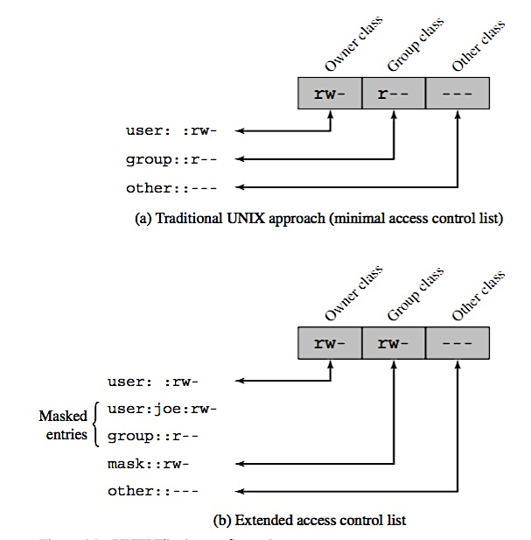
UNIX File Concepts & Access Control
UNIX files administered using inodes
control structure with key info on file
attributes, permissions of a single file
may have several names for same inode
have inode table / list for all files on a disk
copied to memory when disk mounted
directories form a hierarchical tree
may contain files or other directories
are a file of names and inode numbers
Notes:
Now define some basic concepts concerning UNIX files and directories.
All types of UNIX files are administered by the operating system by means of inodes. An inode (index node) is a control structure that contains the key information needed by the operating system for a particular file. Several file names may be associated with a single inode, but an active inode is associated with exactly one file, and each file is controlled by exactly one inode. The attributes of the file as well as its permissions and other control information are stored in the inode. On the disk, there is an inode table, or inode list, that contains the inodes of all the files in the file system. When a file is opened, its inode is brought into main memory and stored in a memory-resident inode table.
Directories are structured in a hierarchical tree. Each directory can contain files and/or other directories. A directory that is inside another directory is referred to as a subdirectory. A directory is simply a file that contains a list of file names plus pointers to associated inodes. Thus, associated with each directory is its own inode.

Slide 19
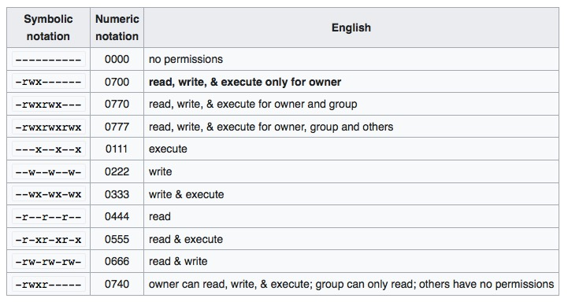
Symbolic Notation for Access Control

Slide 20
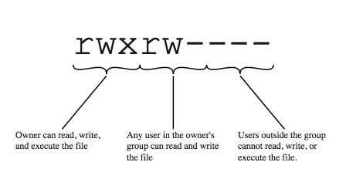
UNIX File Access Control
Notes:
Most UNIX systems depend on, or at least are based on, the file access control scheme introduced with the early versions of UNIX.Each UNIX user is assigned a unique user identification number (user ID). A user is also a member of a primary group,and possibly a number of other groups, each identified by a group ID. When a file is created, it is designated as owned by a particular user and marked with that user’s ID. It also belongs to a specific group, which initially is either its creator’s primary group, or the group of its parent directory if that directory has SetGID permission set. Associated with each file is a set of 12 protection bits. The owner ID, group ID, and protection bits are part of the file’s inode. Nine of the protection bits specify read, write, and execute permission for the owner of the file, other members of the group to which this file belongs, and all other users. These form a hierarchy of owner, group, and all others, with the highest relevant set of permissions being used. Figure 4.6a from the text shows an example in which the file owner has read and write access; all other members of the file’s group have read access, and users outside the group have no access rights to the file. When applied to a directory,the read and write bits grant the right to list and to create/ rename/ delete files in the directory. The execute bit grants to right to search the directory for a component of a filename. The remaining three bits define special additional behavior for files or directories. Two of these are the “set user ID”(SetUID) and “set group ID”(SetGID) permissions. The final permission bit is the “Sticky”bit.

Slide 21
UNIX File Access Control
“Set user id”(setuid) or “set group id”(setgid)
System temporarily uses rights of the file owner / group in addition to the real user’s rights when making access control decisions
Enables privileged programs to access files / resources not generally accessible
Sticky bit
On directory limits rename/move/delete to owner
Superuser
Is exempt from usual access control restrictions
Notes:
If the “set user ID”(SetUID) and “set group ID”(SetGID) are set on an executable file, the operating system functions as follows. When a user (with execute privileges for this file) executes the file,the system temporarily allocates the rights of the user’s ID of the file creator, or the file’s group, respectively, to those of the user executing the file. These are known as the “effective user ID”and “effective group ID” and are used in addition to the “real user ID” and “real group ID” of the executing user when making access control decisions for this program. This change is only effective while the program is being executed. This feature enables the creation and use of privileged programs that may use files normally inaccessible to other users. It enables users to access certain files in a controlled fashion. Alternatively, when applied to a directory, the SetGID permission indicates that newly created files will inherit the group of this directory. The SetUID permission is ignored. The final permission bit is the “Sticky”bit. When set on a file, this originally indicated that the system should retain the file contents in memory following execution. This is no longer used. When applied to a directory, though, it specifies that only the owner of any file in the directory can rename, move, or delete that file. This is useful for managing files in shared temporary directories.
One particular user ID is designated as “superuser.” The superuser is exempt from the usual file access control constraints and has systemwide access. Any program that is owned by, and SetUID to, the “superuser” potentially grants unrestricted access to the system to any user executing that program. Hence great care is needed when writing such programs. This access scheme is adequate when file access requirements align with users and a modest number of groups of users.

Slide 22
UNIX Access Control Lists
Modern UNIX systems support ACLs
Can specify any number of additional users/groups and associated rwx permissions
ACLs are optional extensions to std perms
The owner/other class entries have the same meaning as normal
The group class entry in specifies group permissions. These permissions represent the maximum permissions that can be assigned to named users or named groups, other than the owning user, and hence functions as a mask
Additional named users and named groups may be associated with the file, each with a 3-bit permission field
When access is required
Select most appropriate ACL
Owner, named users, owning / named groups, others
Check if have sufficient permissions for access
Notes:
Many modern UNIX and UNIX-based operating systems support access control lists, including FreeBSD, OpenBSD, Linux, and Solaris. FreeBSD allows the administrator to assign a list of UNIX user IDs and groups to a file by using the setfacl command. Any number of users and groups can be associated with a file, each with three protection bits (read, write, execute), offering a flexible mechanism for assigning access rights. A file need not have an ACL but may be protected solely by the traditional UNIX file access mechanism. FreeBSD files include an additional protection bit that indicates whether the file has an extended ACL. FreeBSD and most UNIX implementations that support extended ACLs use the following strategy:
The owner / other class entries have the same meaning as normal.
The group class entry in specifies group permissions. These permissions represent the maximum permissions that can be assigned to named users or named groups, other than the owning user, and hence functions as a mask.
Additional named users and named groups may be associated with the file, each with a 3-bit permission field.
When a process requests access to a file system object, two steps are performed. Step 1 selects the ACL entry that most closely matches the requesting process. The ACL entries are looked at in the following order: owner, named users, (owning or named) groups, others. Only a single entry determines access. Step 2 checks if the matching entry (which may be one of several group entries) contains sufficient permissions.

Slide 23
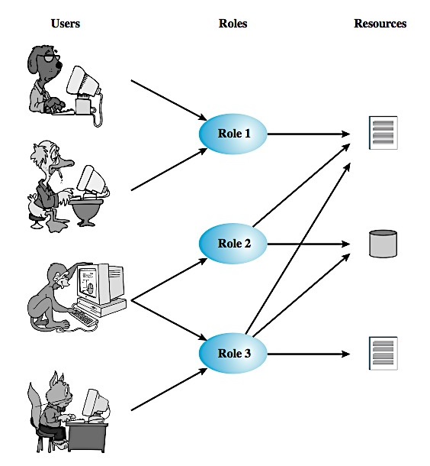
Role-Based Access Control (RBAC)
Users, Roles, and Resources
Notes:
Traditional DAC systems define the access rights of individual users and groups of users. In contrast, RBAC is based on the roles that users assume in a system rather than the user's identity. Typically, RBAC models define a role as a job function within an organization. RBAC systems assign access rights to roles instead of individual users. In turn, users are assigned to different roles, either statically or dynamically, according to their responsibilities. RBAC now enjoys widespread commercial use and remains an area of active research.
The relationship of users to roles is many to many, as is the relationship of roles to resources, or system objects, as shown here in Figure 4.7 from the text. The set of users changes, in some environments frequently and the assignment of a user to one or more roles may also be dynamic. The set of roles in the system in most environments is likely to be static, with only occasional additions or deletions. Each role will have specific access rights to one or more resources. The set of resources and the specific access rights associated with a particular role are also likely to change only infrequently.

Slide 24
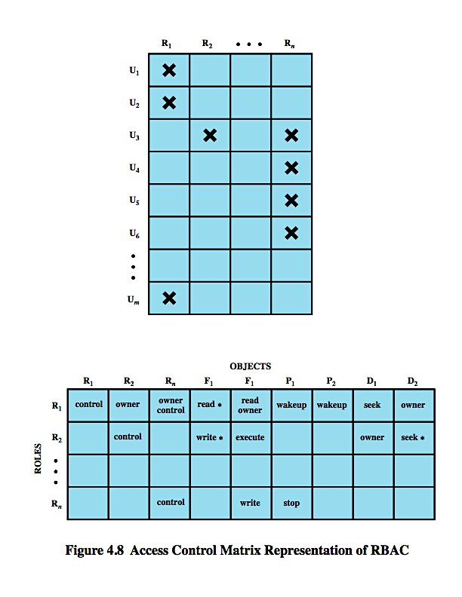
Role-Based Access Control
Access Control Matrix Representation of RBAC
Notes:
We can use the access matrix representation to depict the key elements of an RBAC system in simple terms, as shown in Figure 4.8. The upper matrix relates individual users to roles. Typically there are many more users than roles. Each matrix entry is either blank or marked, the latter indicating that this user is assigned to this role. Note that a single user may be assigned multiple roles (more than one mark in a row) and that multiple users may be assigned to a single role (more than one mark in a column). The lower matrix has the same structure as the DAC access control matrix, with roles as subjects. Typically, there are few roles and many objects, or resources. In this matrix the entries are the specific access rights enjoyed by the roles. Note that a role can be treated as an object, allowing the definition of role hierarchies.
RBAC lends itself to an effective implementation of the principle of least privilege. Each role should contain the minimum set of access rights needed for that role. A user is assigned to a role that enables him or her to perform only what is required for that role. Multiple users assigned to the same role, enjoy the same minimal set of access rights.

Slide 25
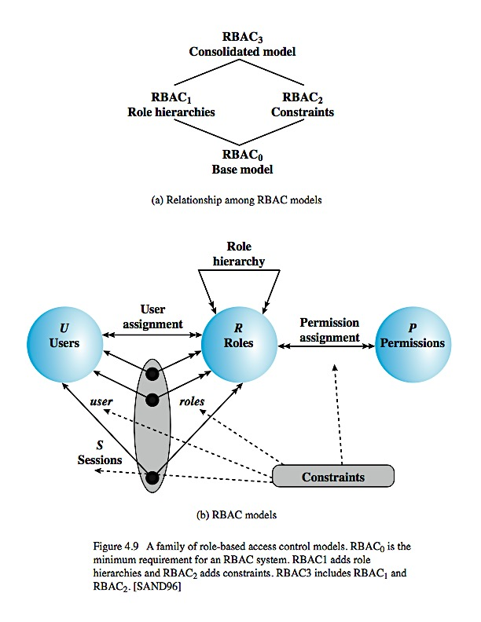
A Family of RBAC Model
Models | Hierarchies | Constraints
RBAC₀ | No | No
RBAC₁ | Yes | No
RBAC₂ | No | Yes
RBAC₃ | Yes | Yes
Minimum Requirement
User: An individuals that has access to this computer system, & associated user ID
Role: A named job function within the organization that controls this computer system. Typically, associated with each role is a description of the authority and responsibility conferred on this role, and on any user who assumes this role
Permission: An approval of a particular mode of access to one or more objects. Equivalent terms are access right, privilege, and authorization
Session: A mapping between a user and an activated subset of the set of roles to which the user is assigned
Notes:
A variety of functions and services can be included under the general RBAC approach. [SAND 96] defines a family of reference models, that consists of four models that are related to each other as shown in Figure 4.9a. and in Table 4.3 in the text. RBAC₀ is contains the minimum functionality for an RBAC system. RBAC₁ includes the RBAC₀ functionality and adds role hierarchies, which enable one role to inherit permissions from another role. RBAC₂ includes RBAC₀ and adds constraints, which restricts the ways in which the components of a RBAC system may be configured. RBAC₃ includes RBAC₀ plus the added functionality of both RBAC₁ and RBAC₂. An RBAC₀ system contains the four types of entities:
• User: An individuals that has access to this computer system, & associated user ID.
• Role: A named job function within the organization that controls this computer system. Typically, associated with each role is a description of the authority and responsibility conferred on this role, and on any user who assumes this role.
• Permission: An approval of a particular mode of access to one or more objects. Equivalent terms are access right, privilege, and authorization.
• Session: A mapping between a user and an activated subset of the set of roles to which the user is assigned.
The solid lines in Figure 4.9b indicate relationships, or mappings, with a single arrowhead indicating one and a double arrowhead indicating many. Thus, there is a many-to-many relationship between users and roles: one user may have multiple roles, and multiple users may be assigned to a single role. Similarly, there is a many-to-many relationship between roles and permissions. See text for more details.

Slide 26
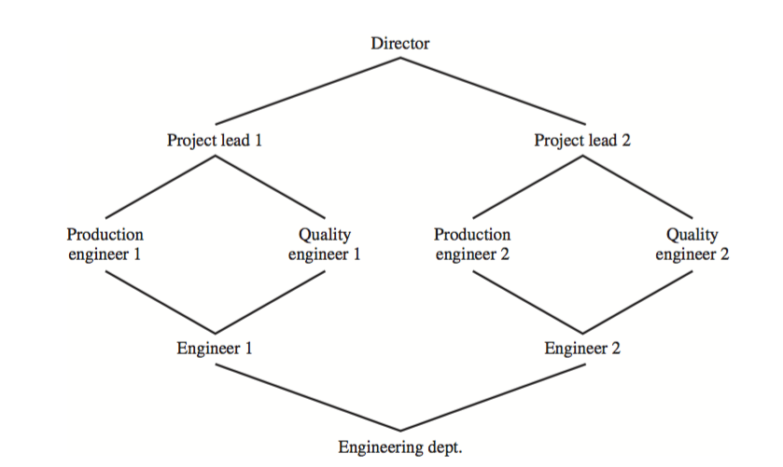
Example of Role Hierarchy
Mutually Exclusive Roles
Cardinality
Prerequisite Role
Constraints

Slide 27
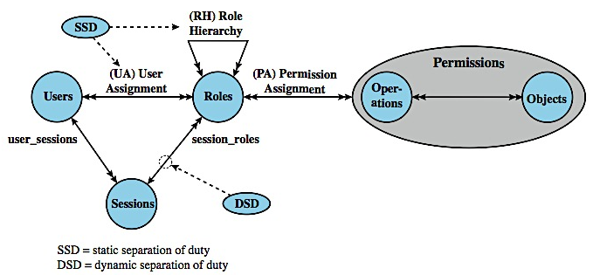
NIST RBAC Model
Notes:
In 2001, NIST proposed a consensus model for RBAC, and has been adopted as ANSI INCITS 359-2004. The main innovation of the NIST standard is the introduction of the RBAC System and Administrative Functional Specification, which defines the features required for an RBAC system in three categories:
• Administrative functions: provide the capability to create, delete, and maintain RBAC elements and relations
• Supporting system functions: provide functions for session management and for making access control decisions
• Review functions: provide the capability to perform query operations on RBAC elements and relations
The NIST RBAC model comprises four model components (Figure 4.11): core RBAC, hierarchical RBAC, static separation of duty (SSD) relations, and dynamic separation of duty (DSD) relations. The elements of core RBAC are the same as those of RBAC₀ described in the preceding section: users, roles, permissions, and sessions. The NIST model elaborates on the concept of permissions by introducing two subordinate entities: operations and objects. Hierarchical RBAC includes the concept of inheritance described for RBAC₁, that greatly simplifies the task of defining permission relationships. SSD and DSD are two components that add constraints to the NIST RBAC model. The constraints are in the form of separation of duty relations, used to enforce conflict of interest policies that organizations may employ to prevent users from exceeding a reasonable level of authority for their positions. See text for more details.

Slide 28
ATTRIBUTE-BASED ACCESS CONTROL (ABAC)
Attributes are characteristics that define specific aspects of the subject, object, environment conditions, and/or requested operations that are predefined and preassigned by an authority
Attributes contain information that indicates the class of information given by the attribute, a name, and a value:
Class=HospitalRecordsAccess
Name=PatientInformationAccess
Value=MFBusinessHoursOnly
Subject Attributes
Object Attributes
Environment Attributes
A subject is an active entity (e.g., a user, an application, a process, or a device) that causes information to flow among objects or changes the system state. Each subject has associated attributes that define the identity and characteristics of the subject. Such attributes may include the subject’s identifier, name, organization, job title, and so on. A subject’s role can also be viewed as an attribute.
An object, also referred to as a resource, is a passive (in the context of the given request) information system-related entity (e.g., devices, files, records, tables, processes, programs, networks, domains) containing or receiving information. As with subjects, objects have attributes that can be leveraged to make access control decisions. A Microsoft Word document, for example, may have attributes such as title, subject, date, and author. Object attributes can often be extracted from the metadata of the object. In particular, a variety of Web service metadata attributes may be relevant for access control purposes, such as ownership, service taxonomy, or even Quality of Service (QoS) attributes.
These attributes have so far been largely ignored in most access control policies. They describe the operational, technical, and even situational environment or context in which the information access occurs. For example, attributes, such as current date and time, the current virus/hacker activities, and the network’s security level (e.g., Internet vs. intranet), are not associated with a particular subject nor a resource, but may nonetheless be relevant in applying an access control policy.

Slide 29
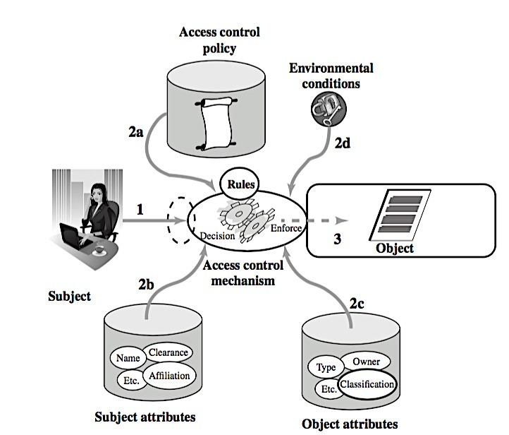
Simple ABAC Scenario
A subject requests access to an object. This request is routed to an access control mechanism.
The access control mechanism is governed by a set of rules (2a) that are defined by a preconfigured access control policy. Based on these rules, the access control mechanism assesses the attributes of the subject (2b), object (2c), and current environmental conditions (2d) to determine authorization.
The access control mechanism grants the subject access to the object if access is authorized and denies access if it is not authorized.

Slide 30
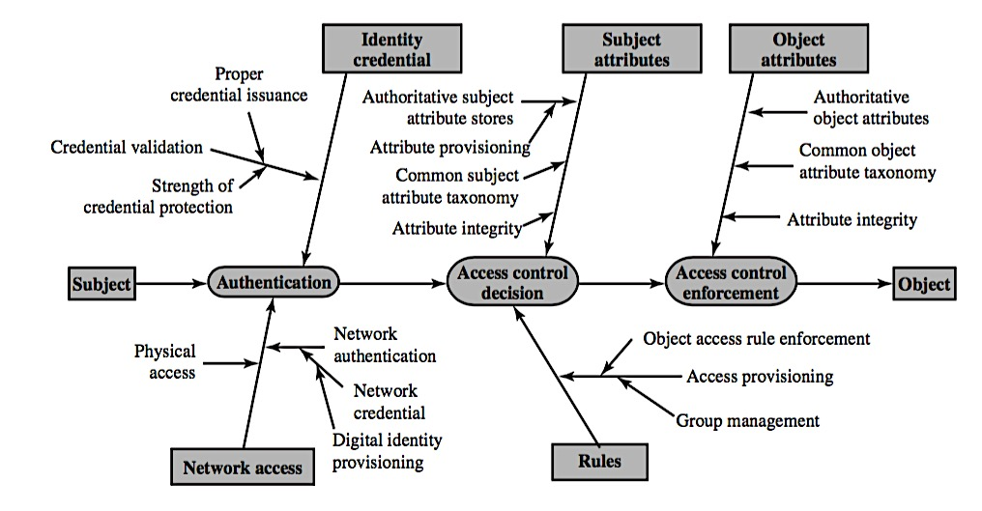
ABAC Policies
A policy is a set of rules and relationships that govern allowable behavior within an organization, based on the privileges of subjects and how resources or objects are to be protected under which environment conditions. In turn, privileges represent the authorized behavior of a subject; they are defined by an authority and embodied in a policy.
Other terms that are commonly used instead of privileges are rights, authorizations, and entitlements.
Policy is typically written from the perspective of the object that needs protecting and the privileges available to subjects.
Movie Rating | Users Allowed Access
R | Age 17 and older
PG-13 | Age 13 and older
G | Everyone
ABAC Trust Chain

Slide 31
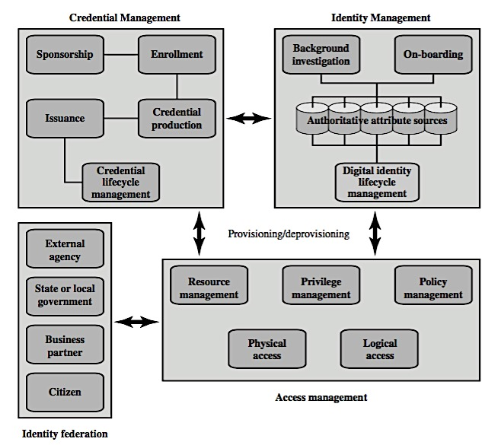
Identity, Credential & Access Management (ICAM)

Slide 32
Identity Management
Identity management is concerned with assigning attributes to a digital identity and connecting that digital identity to an individual or NPE
The goal is to establish a trustworthy digital identity that is independent of a specific application or context
The traditional, and still most common approach, to access control for applications and programs is to create a digital representation of an identity for the specific use of the application or program
A final element of identity management is lifecycle management, which includes the following:
Mechanisms, policies, and procedures for protecting personal identity information
Controlling access to identity data
Techniques for sharing authoritative identity data with applications that need it
Revocation of an enterprise identity

Slide 33
Credential Management
An authorized individual sponsors an individual or entity for a credential to establish the need for the credential. For example, a department supervisor sponsors a department employee.
The sponsored individual enrolls for the credential, a process which typically consists of identity proofing and the capture of biographic and biometric data. This step may also involve incorporating authoritative attribute data, maintained by the identity management component.
A credential is produced. Depending on the credential type, production may involve encryption, the use of a digital signature, the production of a smart- card, or other functions.
The credential is issued to the individual or NPE.
Finally, a credential must be maintained over its life cycle, which might include revocation, reissuance/replacement, reenrollment, expiration, personal identification number (PIN) reset, suspension, or reinstatement.

Slide 34
Access Management
Resource Management
Privilege Management
Policy Management
This element is concerned with defining rules for a resource that requires access control. The rules would include credential requirements and what user attributes, resource attributes, and environmental conditions are required for access of a given resource for a given function.
This element is concerned with establishing and maintaining the entitlement or privilege attributes that comprise an individual’s access profile. These attributes represent features of an individual that can be used as the basis for determining access decisions to both physical and logical resources. Privileges are considered attributes that can be linked to a digital identity.
This element governs what is allowable and unallowable in an access transaction. That is, given the identity and attributes of the requestor, the attributes of the resource or object, and environmental conditions, a policy specifies what actions this user can perform on this object.

Slide 35
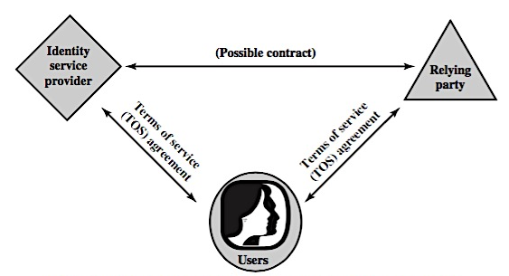
Traditional Triangle of Parties involved in an Exchange of Identity Information
TRUST FRAMEWORKS

Slide 36
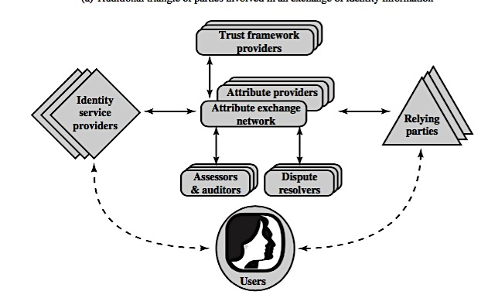
Identity Attribute Exchange Elements
TRUST FRAMEWORKS

Slide 37
Roles Within the Trust framework
Relying Parties (RPs)
Subjects
Attribute Providers (APs)
Identity Providers (IDPs)
Also called service providers, these are entities delivering services to specific users. RPs must have confidence in the identities and/or attributes of their intended users, and must rely upon the various credentials presented to evince those attributes and identities.
These are users of an RP’s services, including customers, employees, trading partners, and subscribers.
APs are entities acknowledged by the community of interest as being able to verify given attributes as presented by subjects and which are equipped through the AXN to create conformant attribute credentials according to the rules and agreements of the AXN. Some APs will be sources of authority for certain information; more commonly APs will be brokers of derived attributes.
These are entities able to authenticate user credentials and to vouch for the names (or pseudonyms or handles) of subjects, and which are equipped through the AXN or some other compatible Identity and Access Management (IDAM) system to create digital identities that may be used to index user attributes.

Slide 38
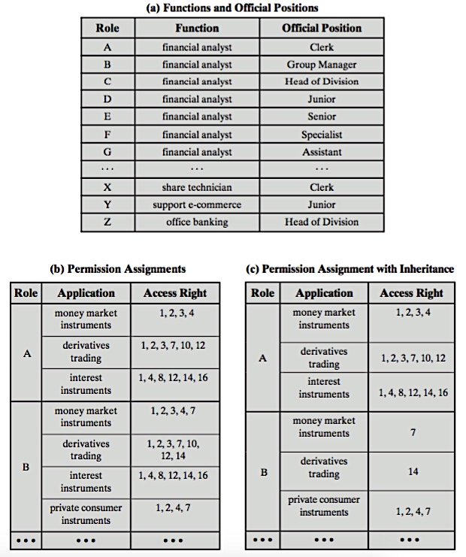
Functions & Roles for Banking Example
Case Study

Slide 39
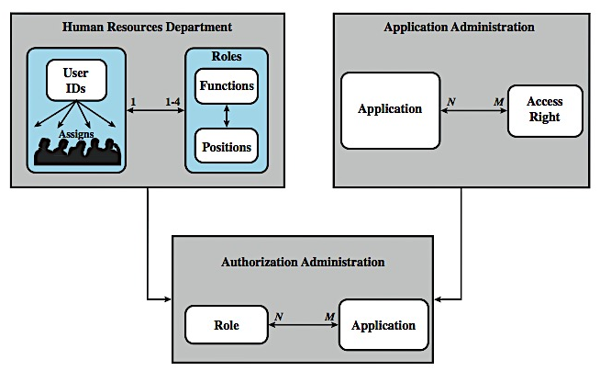
RBAC For a Bank
Notes:
The Dresdner Bank has implemented an RBAC system which is system wide and in which the determination of access rights is compartmentalized into three different administrative units for greater security. Roles within the organization are defined by a combination of official position and job function, and form a role hierarchy in which one role is superior to another if its position is superior and their functions are identical. This makes it possible to economize on access rights definitions.
When a user invokes an application, the application grants access on the basis of a centrally provided security profile. A separate authorization administration associated access rights with roles and creates the security profile for a use on the basis of the user's role. A user is statically assigned to up to 4 roles, and selects a given role for use in invoking a particular application. The user/role information is provided to the Authorization Administration, which creates a security profile for each user that associates the User ID and role with a set of access rights. A role may be used to access several applications. Thus, the set of access rights associated with a role may include access rights that are not associated with one of the applications the user invokes. All of these ingredients are depicted here in Figure 4.12.
Some figures about this system are of interest. Within the bank, there are 65 official positions. These positions are combined with 368 different job functions provided by the human resources database. Potentially, there are 23,920 different roles, but the number of roles in current use is about 1300. This is in line with the experience other RBAC implementations. On average, 42,000 security profiles are distributed to applications each day by the Authorization Administration module.

Slide 40
Summary
Introduced access control principles
Subjects, objects, access rights
Discretionary access controls
Access matrix, access control lists (ACLs), capability tickets
UNIX traditional and ACL mechanisms
Role-based access control
Attribute based access control
Case study
Notes:
Chapter 4 summary.

